Slide 1
Angular JS with WebAPI
Authored by: Shitalkumar | Presented by: Shitalkumar

Slide 2
Agenda
Part - I
Introduction to Angular JS
Angular setup requirement
Angular JS Features/concepts
  Directives, Modules, Controllers
  Services and Factory
  Data binding
  Routing
Part - II
Web API Introduction
Web API call using Angular JS
When to recommend
Pros and Cons
Q&A

Slide 3
Introduction to Angular JS
What is Angular JS
Angular JS is an open source client framework started as a project in Google and currently it is open source project mainly designed for single page application.
Release History
    First release: 20 Oct 2010
    Latest : 1.5.6 – 27 May 2016(latest update on 1 June 16)
    Angular2 Beta
Why Angular?
  MVC components, templates, Two way binding, Routing, Dependency Injection, unit testing, latest browser support, RWD support, "{{data}}" syntax, Angular UI Bootstrap, Angular Material etc.

Slide 4
Angular setup requirement
  Add AngularJS Core Nuget in visual studio web app
  Add a script tag pointing to Angular
  <script src=“angular.js”></script>
  3. Write ng-app directives in HTML application
  Basic Sample(Basic.html)...

Slide 5
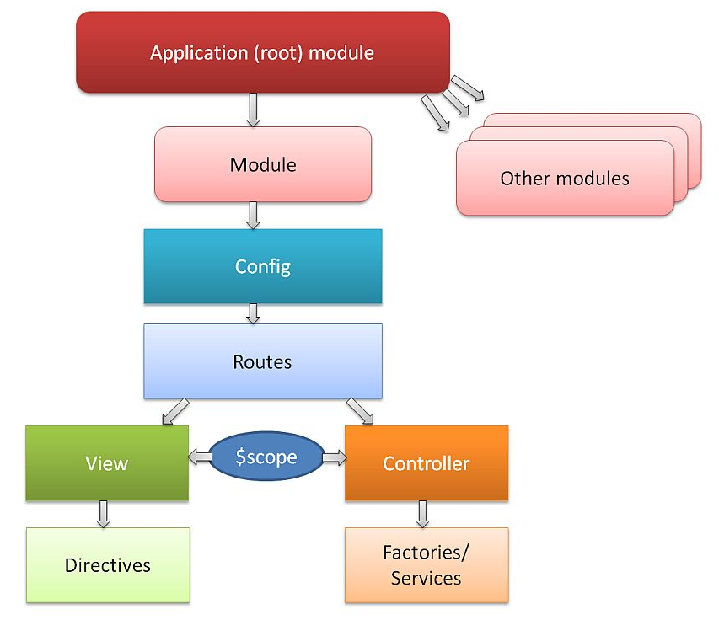
Angular JS Features/concepts
    Angular JS Structure(for complex app)

Slide 6
Angular JS Features
  Directives, Modules, Controllers, Services, Views etc
    Directives (few are…)
Note- You can use data-ng-, instead of ng-, if you want to make your page HTML valid.
      Sample (Directives.html…)
ng-app Declares the root element of an AngularJS app. | ng-show & ng-hide Conditionally show or hide an element
ng-bind binds the innerHTML of the <p> element to the application variable name | ng-switch Conditionally instantiate one template from a set of choices
ng-model Similar to ng-bind, but establishes a two-way data binding between the view and the scope | ng-view The base directive responsible for handling routes
ng-init initializes AngularJS application variables | ng-aria A module for accessibility support of common ARIA attributes
ng-class Lets class attributes be dynamically loaded | ng-include Include other HTML file
ng-controller Specifies a JavaScript controller class | ng-if Basic if statement directive that allow to show the following element if the conditions are true
ng-repeat Instantiate an element once per item from a collection. | ng-click Handles button click

Slide 7
Angular JS Features
  Controller
      Controller is a javascript function. The job of the controller is to build a model of the view to display.
      AngularJS controllers are regular JavaScript Objects. $scope is the application object(the owner of application variables and functions).
      The ng-controller directive defines the application controller.
      External controller
    Example:
    var myController=function($scope){
    $scope.message=“Angular JS Tutorial”;
    }
    Sample (First.html)...

Slide 8
Angular JS Features
  Module
    A module is a container of different parts of your application i.e. controllers, services, directives, filters etc.
    It’s like Main() function in other applications.
    The module is a container for the application controllers. Controller always belongs to a Module.
    Ng-app=‘’’ creates angular app but makes all content/controllers global, so we need to assign module to scope application content locally. Global variables can be accessed and modified easily by external entities so need a module.
    Syntax:
    for setting new module:
    var myApp= angular.module(“myModule”,[]);
    For using existing module:
    angular.module('MyModule').controller('namesCtrl', function ($scope) {
    };
    Sample (First.html)...

Slide 9
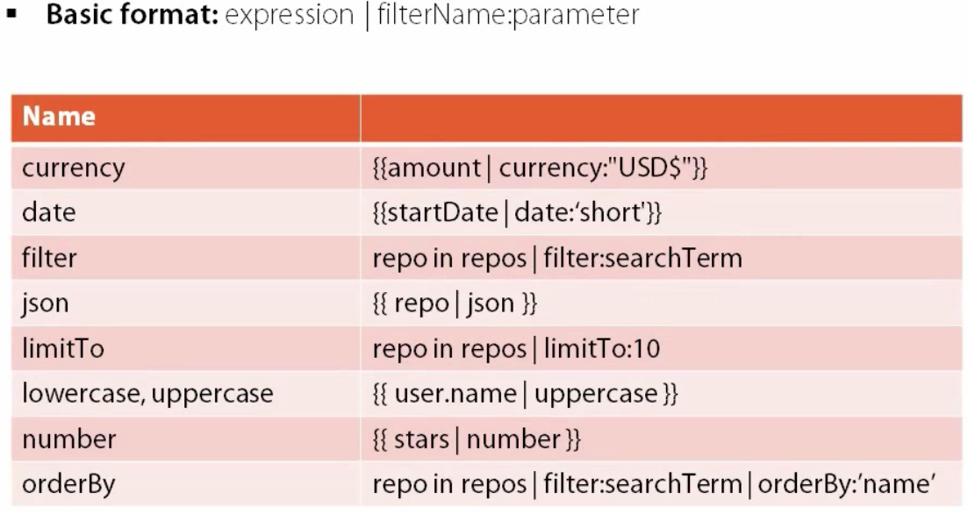
Angular JS Features
  Filters
    Allows to format data for presentation
    Filters can be added to expressions by using the pipe character |, followed by a filter.
  Sample(Filters.html)...
  The filter Filter - The filter filter selects a subset of an array. It can only be used on arrays, and it returns an array containing only the matching items. (AdvFilter.html)
  Custom Filter - You can make your own filters by registering a new filter factory function with your module.(CustomFilter.html)

Slide 10
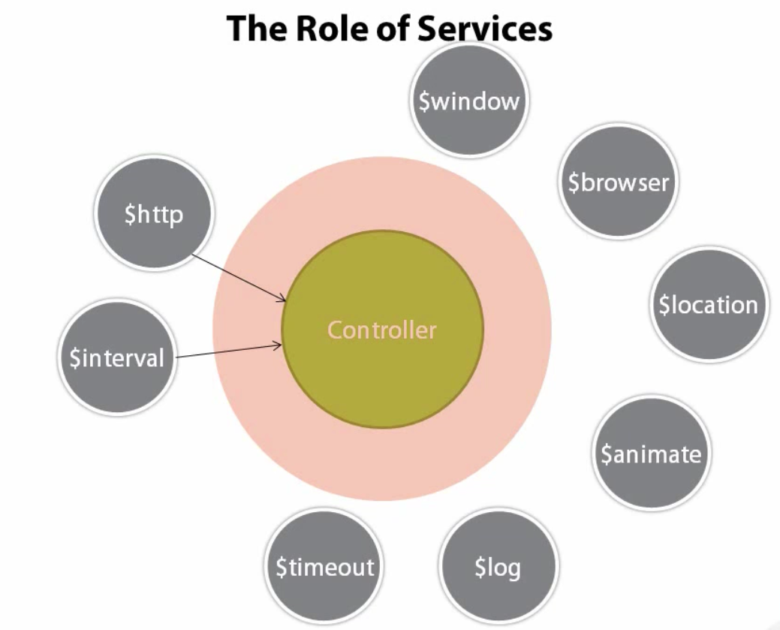
Angular JS Features
  Services
    built in components/functions to perform a specific job
    Around 30 services which we can use or we can develop our own custom service.
  Sample (Service.html)...

Slide 11
Angular JS Features
  Factory
  A factory is a simple function which allows you to add some logic before creating the object. It returns the created object.
  It is just a collection of functions like a class. Hence, it can be instantiated in different controllers when you are using it with constructor function.
  Service scope is at application level and generally service used to perform specific tasks without need to always return any object. But in Factory method, need to return object.
  app.factory('serviceName',function(){ return serviceObj;})
  app.factory('MyFactory', function () {
  var serviceObj = {};
  serviceObj.function1 = function () {
  //TO DO:
  };
  serviceObj.function2 = function () {
  //TO DO:
  };
  return serviceObj;
  });

Slide 12
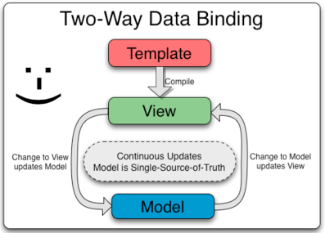
Angular JS Features
  Data Binding
  Sample(DataBinding.html)...

Slide 13
Angular JS Features
  Routing
    Prerequisite – get angular-route.js and add reference in application
    Configure rules into $routeProvider
    Setup a layout view
    Use ng-view to define routing template section
  Index.html/Layout
  Sample(Routedemo\Index.html)…
Header
Hello.html
Api.html
Ngrepeat.html
Footer

Slide 14
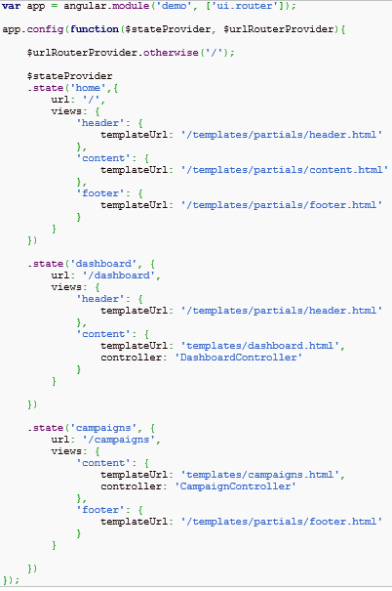
Angular JS Features/concepts
  Angular Router (install package angular-ui-router)

Slide 15
Any Questions?
Have a question now?
 Just ask!
Think of a question later?
shitalkumard@Cybage.com
 8403

Slide 16
Thank you!

